Slide 1
Secret Sheer Minerals Deodorant
By
Shubang Sridhar

Slide 2
Where is it from ?

Slide 3
The Advertisement

Slide 4
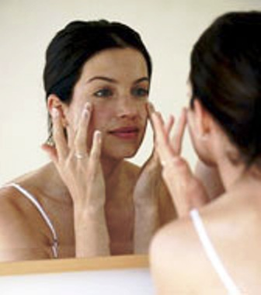
Intended Audience

Slide 5
Colors
Light to Dark
Light Color Skin
Dark Colors
Contrast

Slide 6
Words

Slide 7
Font

Slide 8
Ethics
Women targeted for health related products
Men are targeted using sex appeal
Exposure of women critical to advertisements success

Slide 9
Conclusion
Achieves its purpose
Successfully sells product

Slide 10
References
Where is it from ? http://www.glamour.com/magazine/toc/2010/06/index
Intended Audience http://www.futurederm.com/wp-content/uploads/2008/03/030808-collagen.bmp

